Slide 1
The New Birth

Slide 2
The New Birth
“Jesus answered and said to him, "Truly, truly, I say to you, unless one is born again he cannot see the kingdom of God.”- Jn.3:3 - New American Standard Bible
You Can Experience Two Births in this Life
We have a natural physical birth from our mother and Father.
Then we can experience a spiritual birth through Jesus Christ. This birth gives you access into His Kingdom.

Slide 3
The New Birth
King James Version
“In my Father's house are many mansions: if it were not so, I would have told you. I go to prepare a place for you.” Jn. 14:2

Slide 4
The New Birth
1 Timothy 1:15 (NKJV)
15 “This is a faithful saying and worthy of all acceptance, that Christ Jesus came into the world to save sinners, of whom I am chief.”

Slide 5
The New Birth
John 3:17 (NKJV)
17 “For God did not send His Son into the world to condemn the world, but that the world through Him might be saved.”
Salvation: deliverance, rescue, also safety, welfare;

Slide 6
The New Birth
Acts 2:21 (NKJV)
21 And it shall come to pass
That whoever calls on the name of the Lord Shall be saved.’[a]

Slide 7
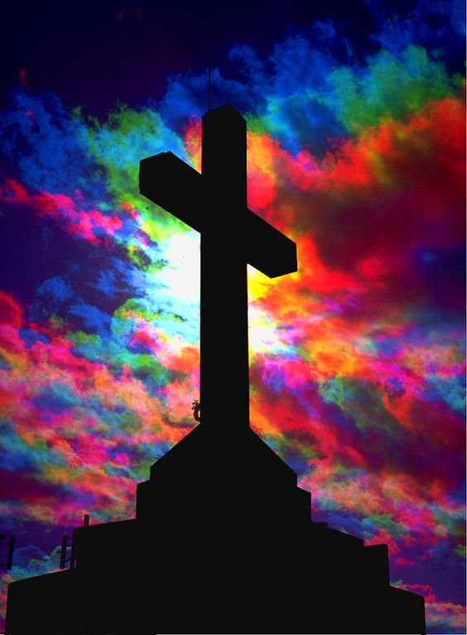

Slide 8
The New Birth
What does it mean to be saved?
a. To be saved means to be born again , to become a child of God.
To Be Saved means to have your sins forgiven.
To be saved means to receive a new spiritual life.
To be saved means to receive peace.
To Be Saved means to have Fellowship with God

Slide 9
The New Birth
What does it mean to be saved?
To be saved means to be born again , to become a child of God.
John 3:16 (NKJV)
16 “For God so loved the world that He gave His only begotten Son, that whoever believes in Him should not perish but have everlasting life.”

Slide 10
The New Birth
John 1:12(NKJV)
12 “But as many as received Him, to them He gave the right to become children of God, to those who believe in His name:”

Slide 11
The New Birth
John 3:7 (NKJV)
7 Do not marvel that I said to you, ‘You must be born again.’

Slide 12
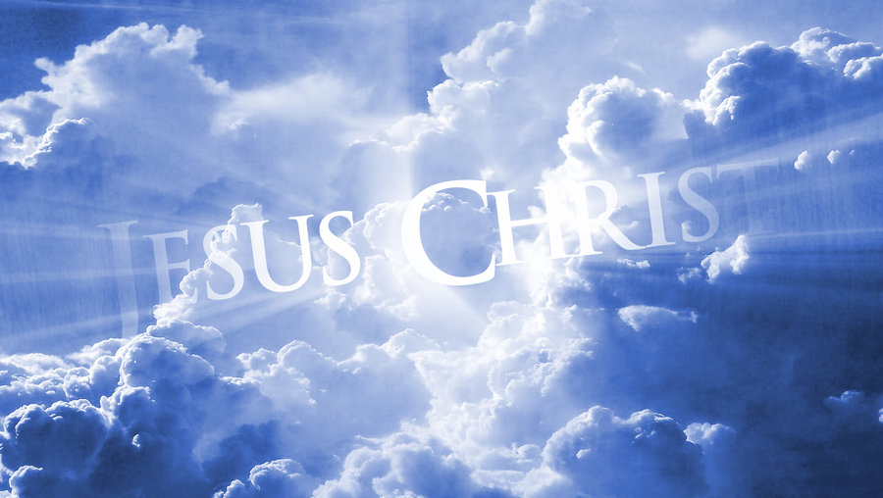

Slide 13
The New Birth
2. To Be Saved means to have your sins forgiven
Psalm 103:3 (NKJV)
3 Who forgives all your iniquities,
Who heals all your diseases,
*Salvation and healing is synonymous.

Slide 14
The New Birth
The Reason Why Jesus Came to earth
Matthew 1:21(NKJV)
21 “And she will bring forth a Son, and you shall call His name Jesus, for He will save His people from their sins.”

Slide 15
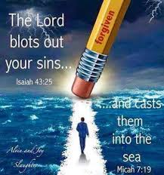

Slide 16
The New Birth
Isaiah 43:25 (NKJV)
25 “I, even I, am He who blots out your transgressions for My own sake;
And I will not remember your sins.”
Jesus blots out your transgression.
He will not remember your sins ….

Slide 17
The New Birth
Hebrews 10:17 (NKJV)
17 then He adds, “Their sins and their lawless deeds I will remember no more.”[a]
*God will not remember your sins and lawless deeds.

Slide 18
The New Birth
Psalm 103:12New King James Version (NKJV)
12 As far as the east is from the west,
So far has He removed our transgressions from us.

Slide 19
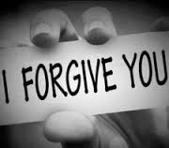

Slide 20
The New Birth
3. To be saved means to receive a new spiritual life.
2 Corinthians 5:17 (NKJV)
17 Therefore, if anyone is in Christ, he is a new creation; old things have passed away; behold, all things have become new.”

Slide 21
The New Birth
A conversion takes place.
Old desires, habits and diseases pass away.
All things become new.
You receive a new life.
A new nature, new health, new ambition.
You receive Christ’s life.

Slide 23
The New Birth
4. To be saved means to receive peace
John 14:27 (NKJV)
27 Peace I leave with you, My peace I give to you; not as the world gives do I give to you. *Let not your heart be troubled, neither let it be afraid.

Slide 24
The New Birth
John 16:33 (NKJV)
33 These things I have spoken to you, that in Me you may have peace. In the world you will[a] have tribulation; but be of good cheer, I have overcome the world.”

Slide 25
The New Birth
Isaiah 57:21 (NKJV)
21 “There is no peace,”
Says my God, “for the wicked.”

Slide 26
The New Birth
Romans 5:1 (NKJV)
Faith Triumphs in Trouble
5 ‘Therefore, having been justified by faith, we have[a] peace with God through our Lord Jesus Christ,
Justified: Just as if you never sinned.

Slide 27
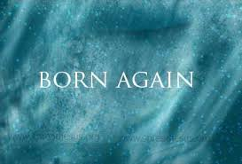

Slide 28
The New Birth
5. To Be Saved means to have Fellowship with God
You were created in God’s likeness so that you can walk and talk with Him.
But your sins separated you from your God.
Now, instead of fellowshipping with God you fear God!
Today, only Christ can save you from your sins!

Slide 29
The New Birth
Proverbs 18:24 (NKJV)
24 A man who has friends must himself be friendly,[a] But there is a friend who sticks closer than a brother.

Slide 30
The New Birth
Isaiah 59:2New King James Version (NKJV)
2 But your iniquities have separated you from your God; And your sins have hidden His face from you, So that He will not hear.

Slide 31
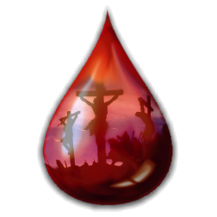

Slide 32
The New Birth
Matthew 26:28 (NKJV)
28 For this is My blood of the new[a] covenant, which is shed for many for the remission of sins.

Slide 33
The New Birth
1 John 1:9 (NKJV)
9 If we confess our sins, He is faithful and just to forgive us our sins and to cleanse us from all unrighteousness.

Slide 34
The New Birth
1 John 3:14 (NKJV)
14 We know that we have passed from death to life, because we love the brethren…”

Slide 36
The New Birth
Call To Christ
Romans 10:9 (NKJV)
9 “that if you confess with your mouth the Lord Jesus and believe in your heart that God has raised Him from the dead, you will be saved.

Slide 37
The New Birth
What does it mean to be saved?
a. To be saved means to be born again , to become a child of God.
To Be Saved means to have your sins forgiven.
To be saved means to receive a new spiritual life.
To be saved means to receive peace.
To Be Saved means to have Fellowship with God

Slide 38
The New Birth
“I have swept away your sins like a cloud. I have scattered your offenses like the morning mist. Oh, return to me, for I have paid the price to set you free.”
Isaiah 44:22 New Living Translation

Slide 39
